Slide 1
eLoc by MapmyIndia
Screenshots

Slide 2
How to use eLoc?
Go to eloc.me
Or download MapmyIndia’s
Android app - Map: Directions & Local Search
iOS app - Map: Directions, Local Searches & Travel Guide

Slide 3
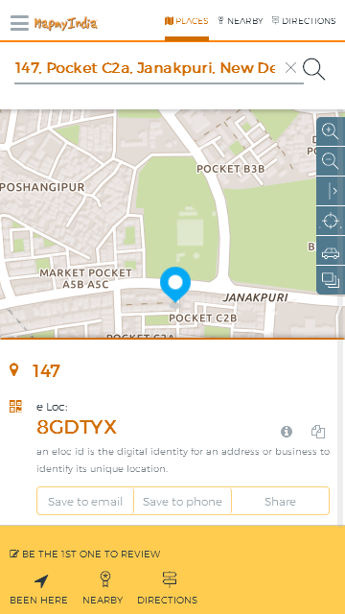
Search for an address to find an eLoc
1. Search for an address to find its eLoc

Slide 4
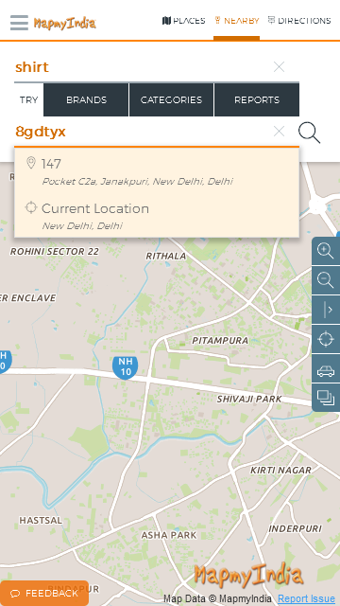
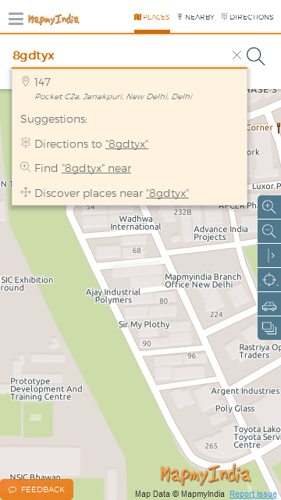
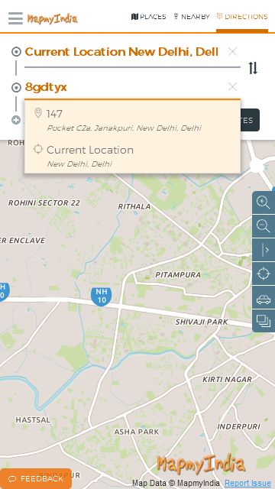
Use this eLoc to search for places, directions or points of interest nearby (like various brands and categories)
Place search
Nearby search
Directions search

Slide 5
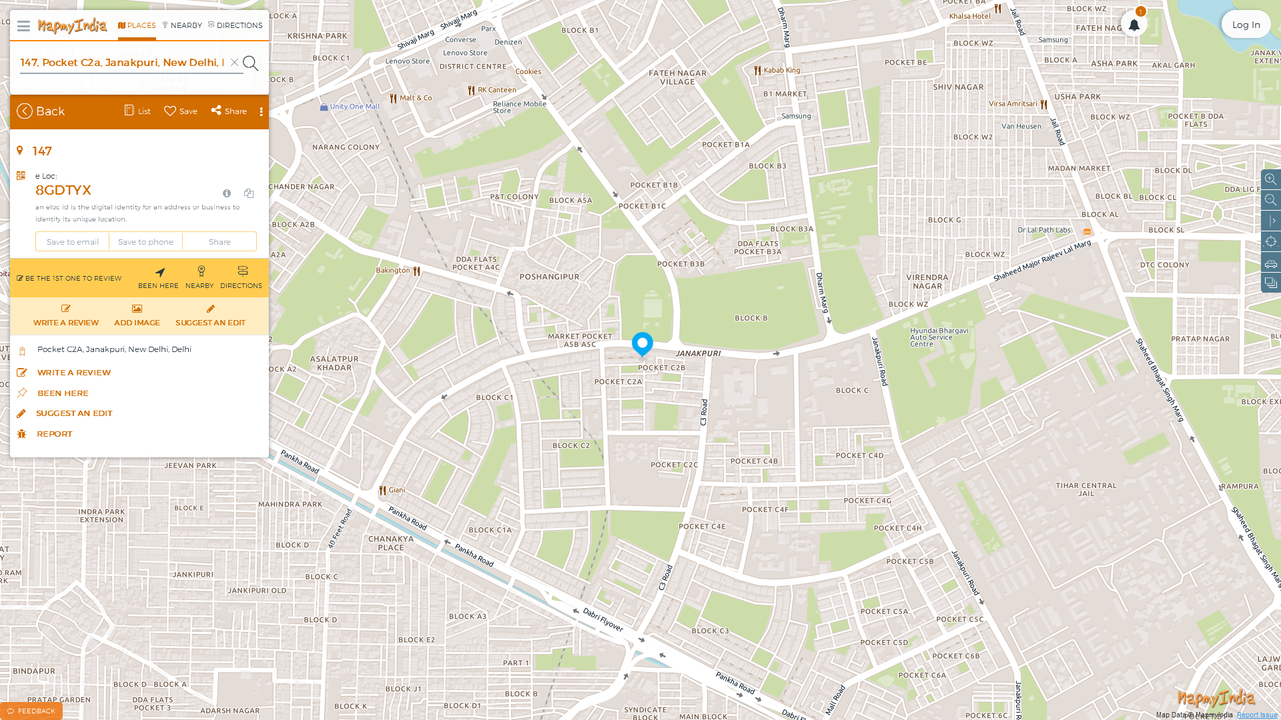
Screenshots from the Web
Search for an address to find its eLoc

Slide 6
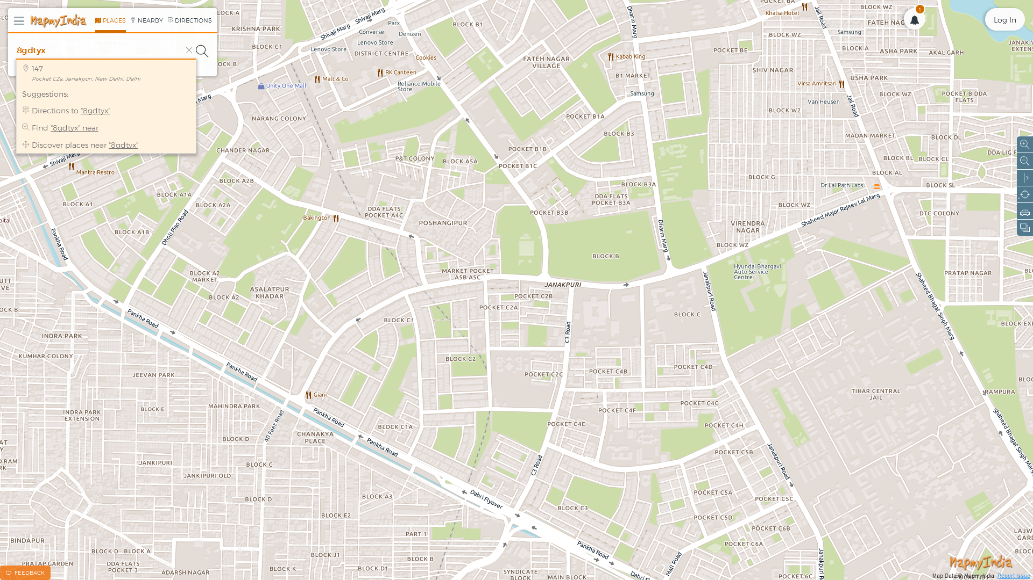
Screenshots from the Web
Use eLoc to search for places, directions and brands & categories nearby

Slide 7
If you can’t find an address – simply add it to get an instant eLoc!

Slide 8
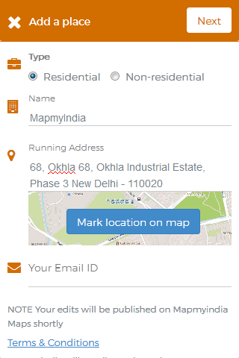
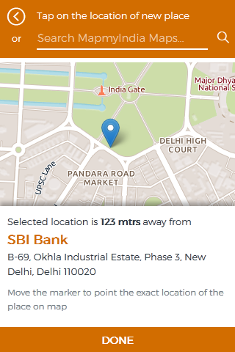
Input the required information and mark the point on map
Place the marker on the required location and click done

Slide 9
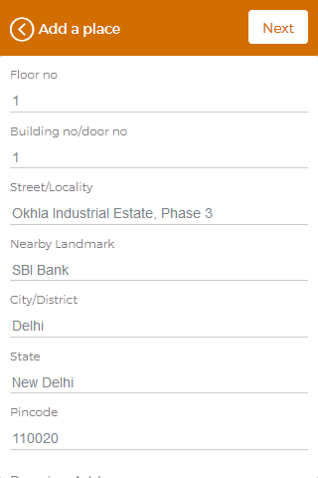
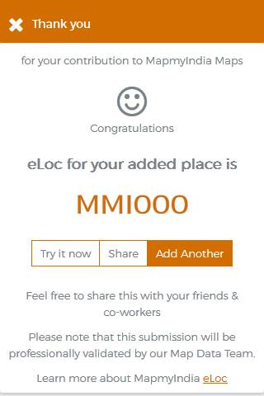
Fill the required information and click next
Your eLoc is now generated! Use, save & share!!

